Slide 1
The Molecular, Biochemical, and Cellular Basis of Genetic Disease

Slide 2
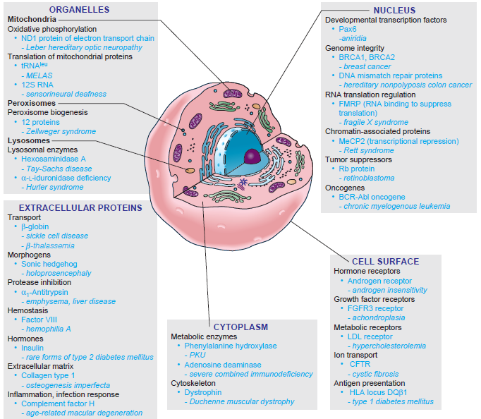
Examples of the classes of proteins associated with diseases with a strong genetic component, and the part of the cell in which those proteins normally function

Slide 3
Proteins can be separated into two general classes on the basis of their pattern of expression:
Housekeeping proteins
Specialty proteins
Two broad generalizations can be made about the relationship between the site of a protein’s expression and the site of disease:
First , mutation in a tissue-specific protein most often produces a disease restricted to that tissue. Exception, phenylketonuria, phenylalanine hydroxylase, expressed in liver, damage happen in brain
Second, although housekeeping proteins are expressed in most or all tissues, the clinical effects of mutations in housekeeping proteins are frequently limited to one or just a few tissues
Tay-Sachs disease, hexosaminidase A
genetic redundancy

Slide 4
Diseases involving enzymes
Aminoacidopathies
Hyperphenylalaninemias
Phenylketonuria

Slide 5
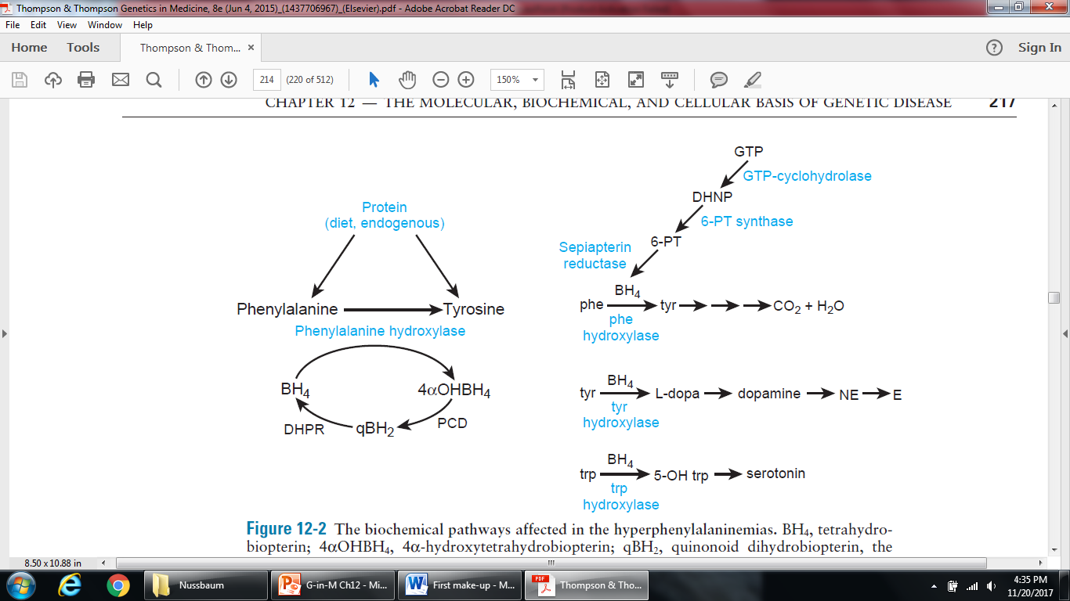
neurotransmitters
The biochemical pathways affected in the hyperphenylalaninemias

Slide 6
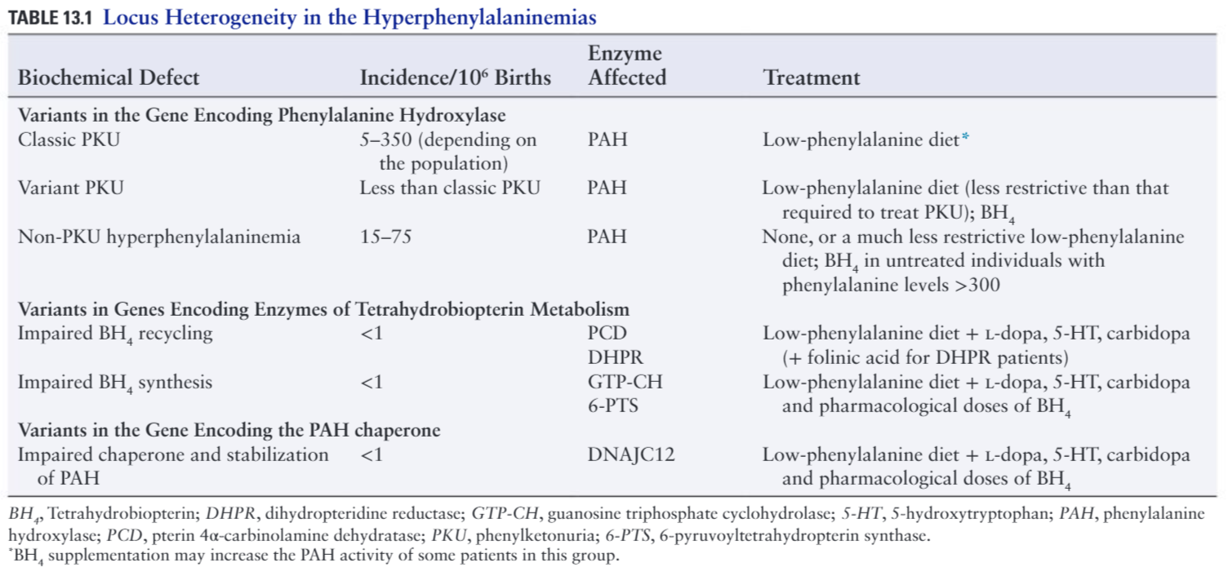

Slide 7
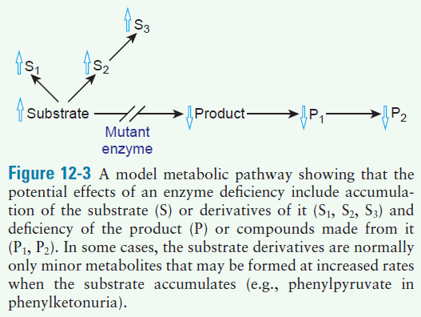
In phenylketonuria, phenylalanine (substrate) accumulates and damages the developing CNS in early childhood
Neurological damage can be largely avoided by reducing dietary intake of phenylalanine

Slide 8
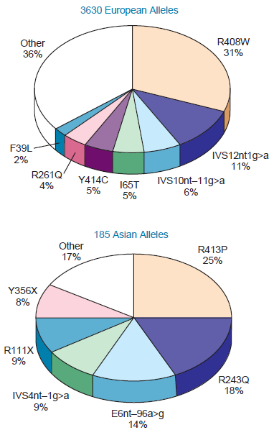
Allelic heterogeneity at the PAH locus
The nature and identity of PAH mutations in populations of European and Asian descent
Homozygous patients with certain PAH mutations show phenotypes ranging all the way from classic PKU to non-PKU hyperphenylalaninemia, accordingly, other unidentified biological variables, including modifier genes, generate phenotypic variation

Slide 9
Mutations in PAH and defects in biosynthesis or regeneration of cofactor BH4 (1-3%) can cause disease [locus heterogeneity]
BH4 deficient patients were first recognized because they developed disease despite low phenylalanine diet
BH4 is required for tyrosine hydroxylase and tryptophan hydroxylase, both critical for synthesis of neurotransmitters
In case of BH4 defects, doses of oral BH4 can restore defects and administration of tyr- and trp-hydroxylase products can normalize neurotransmitters
BH4 supplementation can have beneficial effects through:
Stabilization of the enzyme
Protection of the enzyme from degradation by the cell
Increase in cofactor supply for an altered enzyme that has low affinity for BH4

Slide 10
Newborn screening for PKU is justified because:
Common (1 in 2900 live births)
Mass screening is feasible
Failure to treat has severe consequences
Treatment is effective if begun early in life
Maternal PKU

Slide 11
Lysosomal storage diseases
GM2 gangliosidoses
Tay-Sachs disease mutation in α
Sandhoff disease mutation in β
activator deficiency mutation in activator protein gene
Clinical manifestations of defects in the three genes are indistinguishable, but they can be differentiated by enzymatic analysis
Tay-Sachs disease characterized by cherry-red spot in the retina (effect of neuronal death)

Slide 12
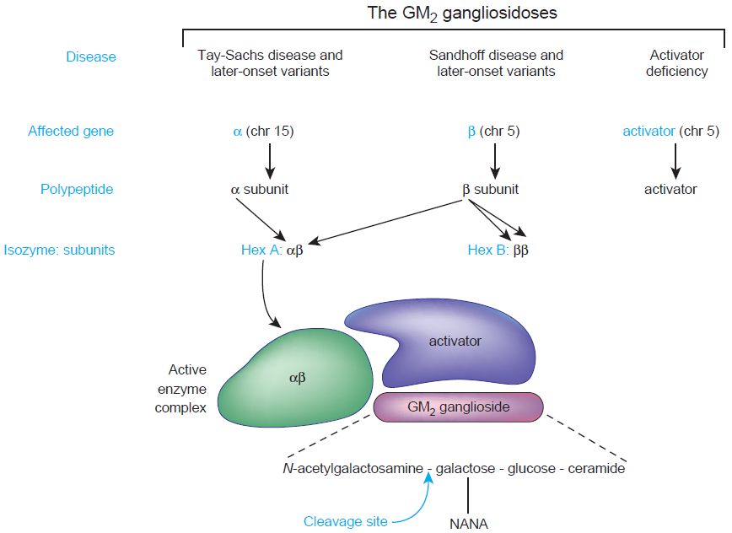
The three-gene system required for hexosaminidase A activity and the diseases that result from defects in each of the genes

Slide 13
Hex A pseudodeficiency alleles and their clinical significance
Pseudodeficiency allele: a clinically benign allele that has a reduction in functional activity detected by in vitro assays but that has sufficient activity in vivo to prevent haploinsufficiency
May complicate prenatal diagnosis

Slide 14
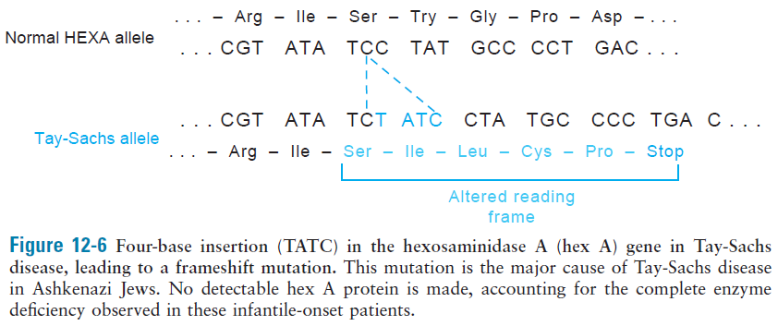
Three alleles account for 99% of the mutations found in Ashkenazi Jewish patients, the most common of which account for 80% of cases: c.1274_1277dupTATC (p.Tyr427Ilefs*5)
Incidence is 100 times higher in Ashkenazi Jewish
Figure 12-6 Four-base insertion (TATC) in the hexosaminidase A (hex A) gene in Tay-Sachs
disease, leading to a frameshift mutation. This mutation is the major cause of Tay-Sachs disease
in Ashkenazi Jews. No detectable hex A protein is made, accounting for the complete enzyme
deficiency observed in these infantile-onset patients.

Slide 15
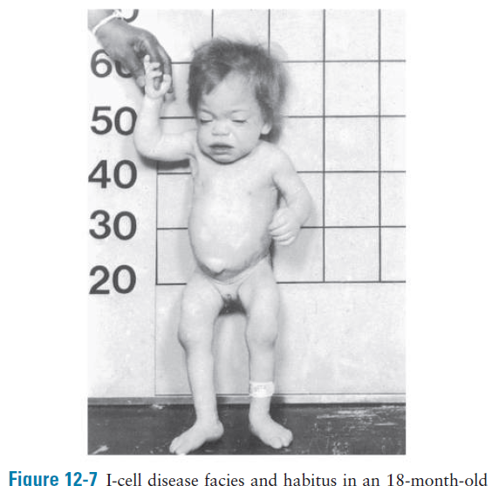
Altered protein function due to abnormal post-translational modification
A loss of glycosylation: I-cell disease
Cytoplasm of cultured fibroblasts from patients contains abnormal lysosomes or inclusions
Defect in the enzyme that transfers a phosphate group to the mannose residue in the hydrolase
Mannose-6-phosphate residues are essential for recognition of the hydrolases by receptors on the cell and lysosomal membrane surface

Slide 16
Loss of protein function due to impaired binding or metabolism of cofactors
Impaired cofactor binding: homocystinuria due to cystathionine synthase deficiency
Dislocation of the lens
Intellectual disability
Osteoporosis
long bones
Thromboembolism
Confused with Marfan syndrome, a disorder of connective tissue

Slide 17
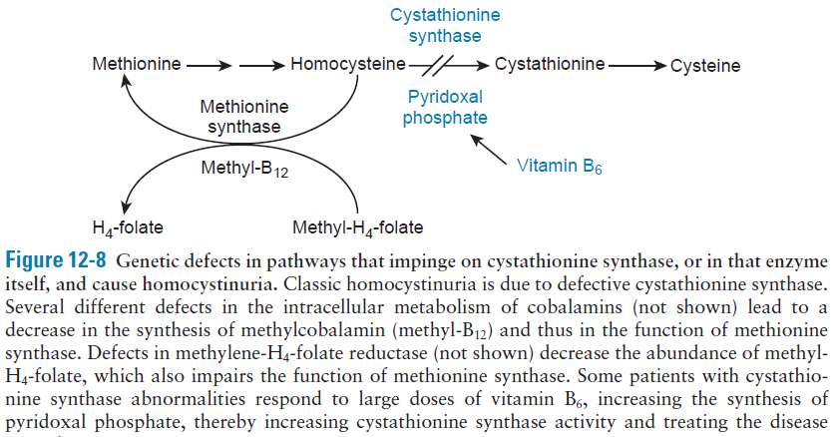
Figure 13-7

Slide 18
Mutations of an enzyme inhibitor: α₁-antitrypsin (α1AT) deficiency
Associated with a substantial risk for chronic obstructive lung disease (emphysema) and cirrhosis of the liver
Inhibit a wide spectrum of proteases, particularly elastase released from neutrophils in the lower respiratory tract
SERPINA1 encodes α1AT protein, multiple alleles associated with disease, most common is the Z allele (Glu342Lys)
Z protein exhibit structural changes in protein predisposing to the formation of long beadlike necklaces of mutant polymers, conferring novel property on the protein (similar to sickle cell disease)
Conformational diseases

Slide 19
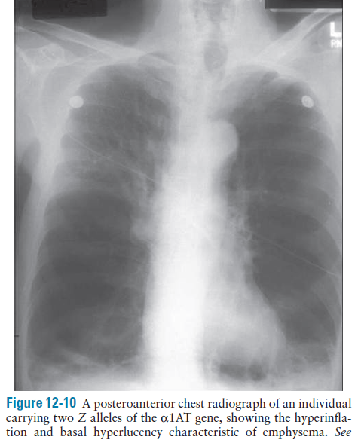
Figure 12-10 A posteroanterior chest radiograph of an individual
carrying two Z alleles of the α1AT gene, showing the hyperinflation
and basal hyperlucency characteristic of emphysema.

Slide 20
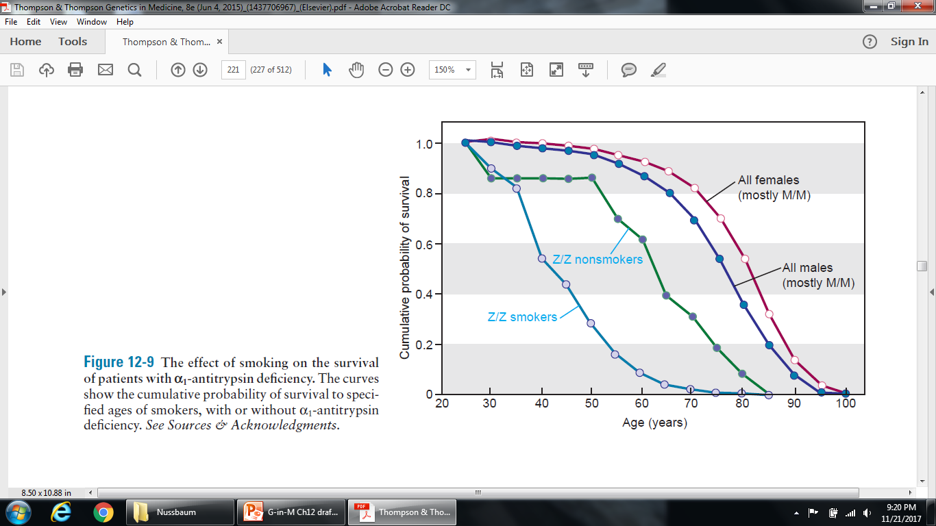
Ecogenetic disease
Active site of α1AT, at methionine 358, is oxidized by both cigarette smoke and inflammatory cells, thus reducing its affinity for elastase by 2000-fold
Figure 12-9 The effect of smoking on the survival
of patients with α1-antitrypsin deficiency. The curves
show the cumulative probability of survival to specified
ages of smokers, with or without α1-antitrypsin
deficiency.

Slide 21
Dysregulation of a biosynthetic pathway: Acute intermittent porphyria (AIP)
Autosomal dominant associated with intermittent neurologic dysfunction caused by deficiency of porphobilinogen deaminase, an enzyme in the biosynthetic pathway of heme, required for synthesis of both hemoglobin and cytochrome p450
Manifestations range from acute abdominal pain to psychosis

Slide 22
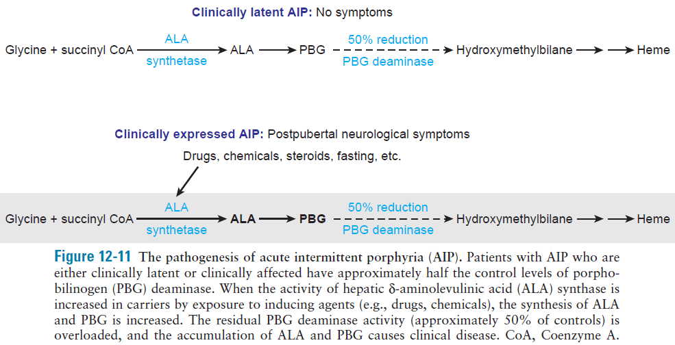
Pharmacogenetic disease
Figure 13-10

Slide 23
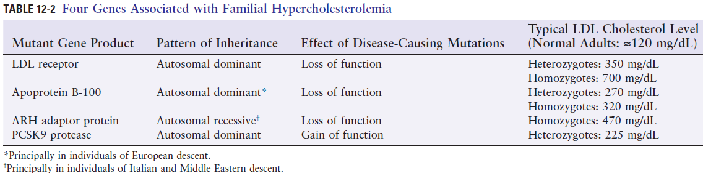
Defects in receptor proteins
Familial hypercholesterolemia
semidominant
All four of the genes associated with familial hypercholesterolemia disrupt the function or abundance either of the:
LDL receptor at the cell surface or of
apoB, the major protein component of LDL and a ligand for the LDL receptor

Slide 24
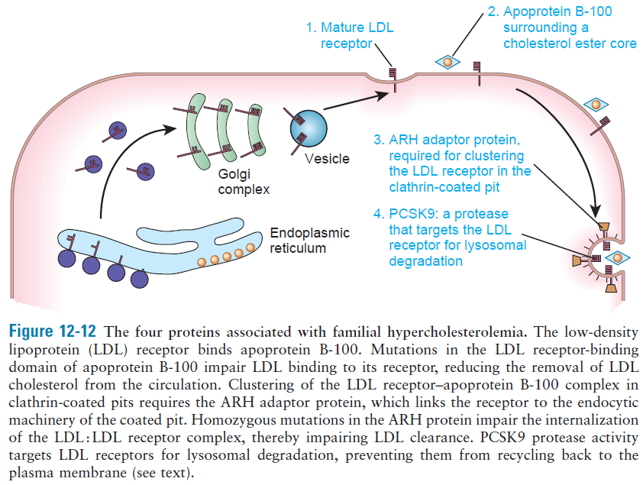
Figure 13-11

Slide 25
Mutations in LDL receptor gene are the most common cause of disease
Elevated plasma LDL cholesterol lead to premature atherosclerosis (accumulation of cholesterol by macrophages in the subendothelial space of major arteries) and increased risk of heart attack and stroke
Xanthomas (cholestrol deposits in skin) and premature arcus corneae (cholesterol deposits around the periphery of the cornea) are body marks of disease

Slide 26
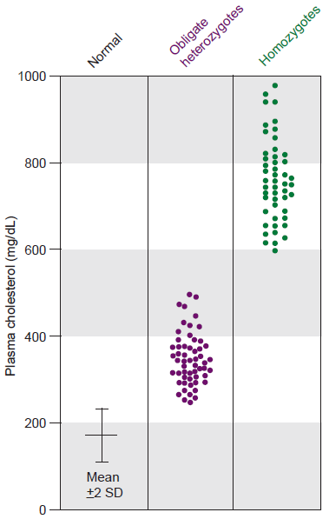
Figure 13-12 Gene dosage in low-density lipoprotein (LDL) deficiency. Shown is the distribution of total plasma cholesterol levels in 49 patients homozygous for deficiency of the LDL receptor, their parents (obligate heterozygotes), and normal controls
Population frequency of the heterozygous form of disease
1 in 500

Slide 27
LDLR mutations can be grouped into six classes:
Null alleles that prevent the synthesis of any detectable receptor
(like those in classes 4 and 6) Define features of the polypeptide critical to its subcellular localization
Mutant receptors reach the cell surface but are incapable of binding LDL
Impair localization of the receptor to the coated pit, and consequently the bound LDL is not internalized
Recycling-defective alleles
Lead to defective targeting of the mutant receptor to the basolateral membrane

Slide 28
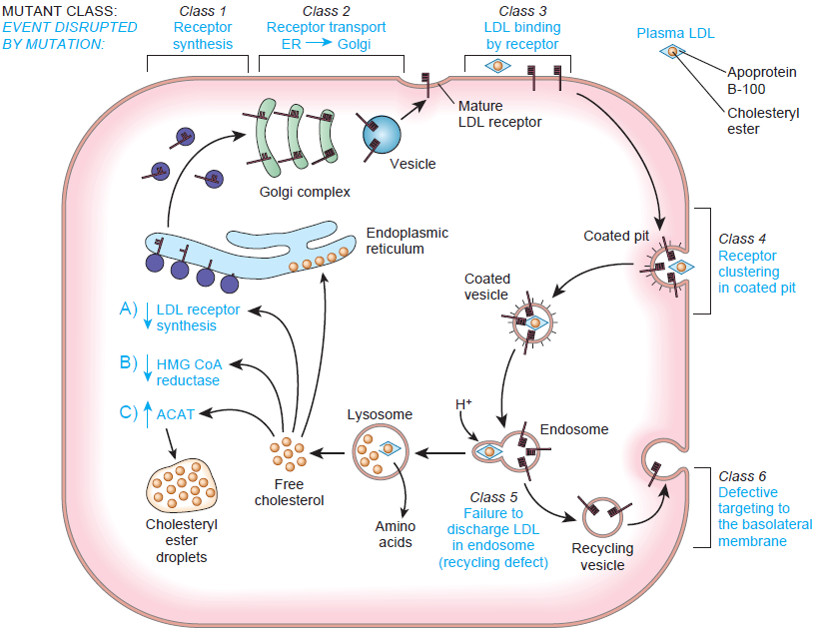
Figure 13-13 The cell biology and biochemical role of the LDL receptor and the six classes of mutations that alter its function

Slide 29
PCSK9 protease, a potential drug target for lowering LDL cholesterol
Rare cases of hypercholesterolemia results from gain-of-function mutations in PCSK9
The role of PCSK9 is to target LDL receptor for lysosomal degradation, thereby, reducing receptor abundance at cell surface
Complete absence of PCSK9 activity in the few known individuals with two PCSK9 null alleles appears to have no adverse clinical consequences

Slide 30
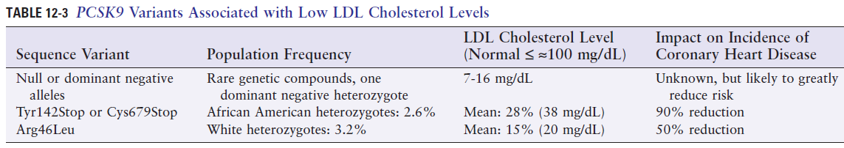
The strong protective effect of PCSK9 loss-of-function alleles, together with the apparent absence of any clinical sequelae in subjects with a total absence of PCSK9 activity, has made PCSK9 a strong candidate target for drugs that inactivate or diminish the activity of the enzyme

Slide 31
Clinical Implications of the Genetics of Familial Hypercholesterolemia
Early diagnosis > application of cholesterol-lowering therapies
> genetic screening of first-degree relatives
Heterozygotes > drug therapy
Homozygotes > plasma apheresis (remove hypercholesterolemic plasma) or liver transplantation
Therapy > statin drugs inhibit de novo cholesterol biosynthesis
> monoclonal antibodies targeting PCSK9, may lower LDL cholesterol by an additional 60%

Slide 32
Transport defects
Cystic fibrosis
The most common autosomal recessive disorder of children in white population, incidence 1 in 2500, carrier frequency 1 in 25.
CFTR, CF transmembrane regulator, a chloride channel
Lungs and exocrine pancreas are the principal organs affected
A major diagnostic feature is increased sweat sodium and chloride
The pancreatic defect in CF is a maldigestion syndrome due to deficient secretion of pancreatic enzymes (sufficient, insufficient)
More than 98% of males are infertile because they lack the vas deferens, congenital bilateral absence of the vas deferens (CBAVD)

Slide 33
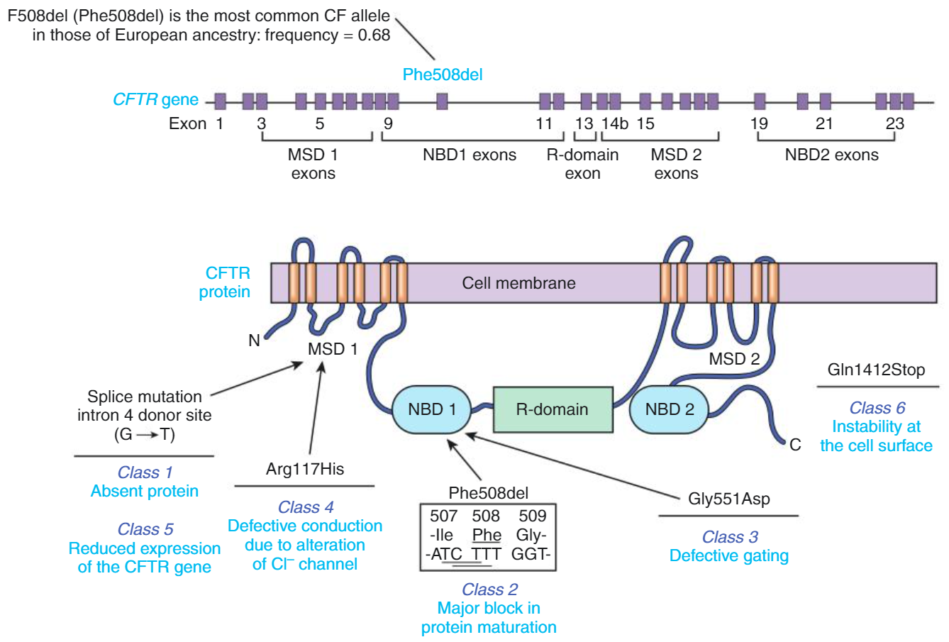
Figure 13-14 The structure of the CFTR gene and a schematic of the CFTR protein

Slide 34
A Cystic Fibrosis Genocopy: Pathogenic variants in the Epithelial Sodium Channel Gene SCNN1
Genocopy: a phenotype that, although genetically distinct, has a very closely related phenotype
Genotype-phenotype correlations in cystic fibrosis
Two generalizations:
The specific CFTR genotype is a good predictor of exocrine pancreatic function.
F508del→pancreatic insufficiency, Arg117His → pancreatic sufficiency
The specific CFTR genotype is a poor predictor of the severity of pulmonary disease
F508del → severity of lung disease is variable

Slide 35
Disorders of structural proteins
The dystrophin glycoprotein complex: Duchenne, Becker, and other muscular dystrophies
Duchenne muscular dystrophy (DMD)
X-linked, mutations in dystrophin gene
Becker muscular dystrophy (BMD)
Mutations in dystrophin gene, much milder phenotype

Slide 36
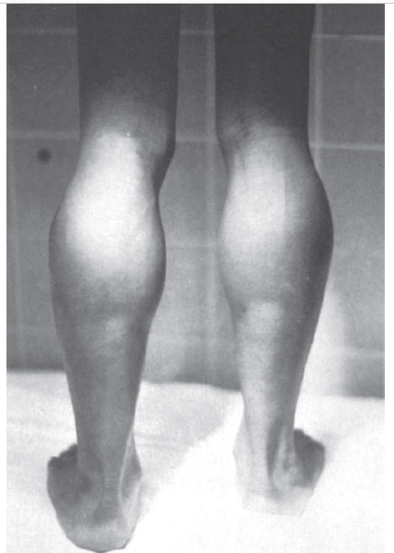
Clinical phenotype of DMD:
Normal first 1 to 2 years
Muscle weakness by 3 or 5 years old
Confined to wheelchair by age of 12
Pulmonary and cardiac complications
Elevated creatine kinase
Moderate decrease in IQ
Clinical phenotype of BMD:
Still walking at age 16
Pseudohypertrophy of the calves due to the replacement of normal muscle tissue with connective tissue and fat in an 8-year-old boy with DMD

Slide 37
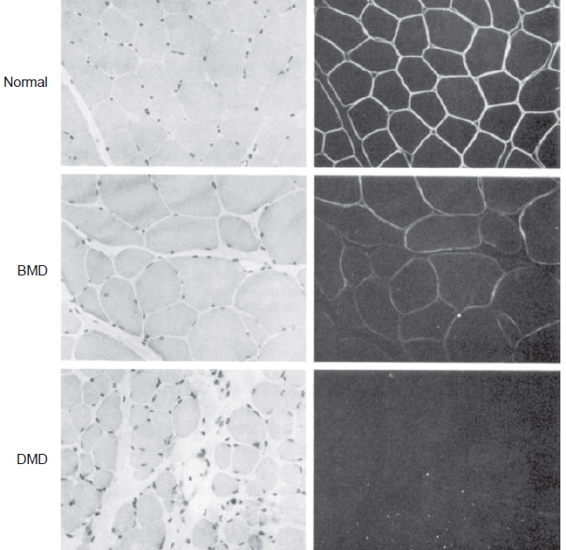
Figure 13-15 Microscopic visualization of the effect of mutations in the dystrophin gene in a patient with BMD and a patient with DMD.
Left column, Hematoxylin and eosin staining of muscle. Right column, Immunofluorescence microscopy staining with an antibody specific to dystrophin. Note the localization of dystrophin to the myocyte membrane in normal muscle, the reduced quantity of dystrophin in BMD muscle, and the complete absence of dystrophin from the myocytes of the DMD muscle. The amount of connective tissue between the myocytes in the DMD muscle is increased.

Slide 38
Genetics of DMD and BMD
DMD incidence 1 in 3300 males
DMD is X-linked recessive lethal in males, one third new mutations, two thirds inherited from mother
Rarely females express disease, some have X;autosome translocation, others have Turner syndrome
BMD accounts for 15% of variants at the locus
Reproductive fitness of BMD is up to 70%
Majority of BMD are inherited ~90%, ~10% due to new mutations

Slide 39
The DMD gene and its product
Size of DMD gene is >2000 kb, 79 exons, 1.5% of the entire X chromosome
Large target for mutations and structurally prone to deletion and duplication

Slide 40
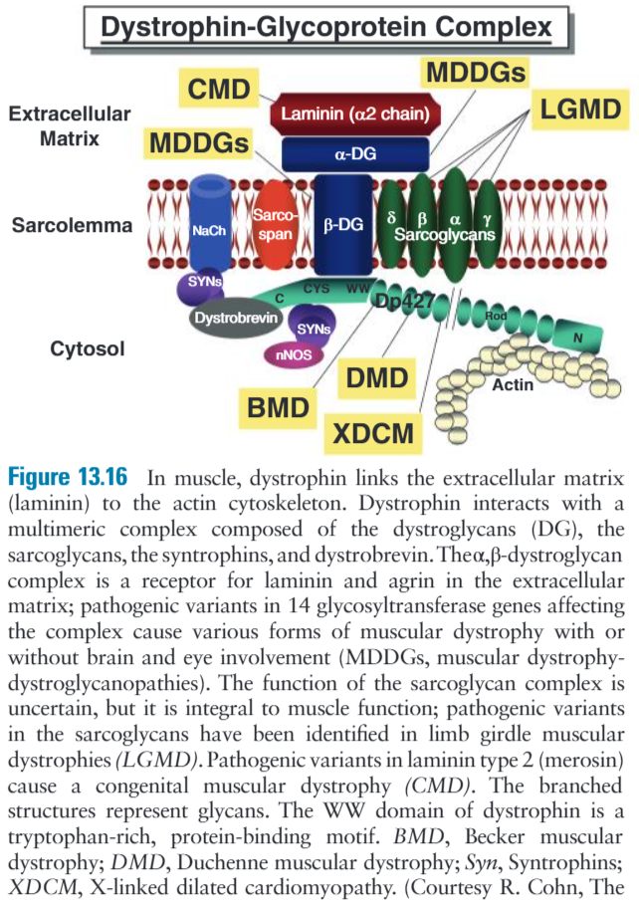

Slide 41
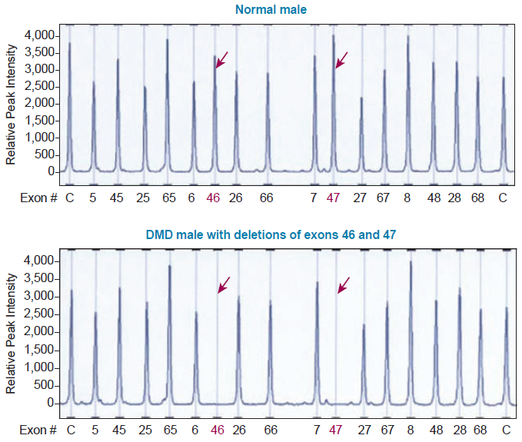
Figure 13-17 Diagnosis of Duchenne muscular dystrophy (DMD) involves screening for deletions and duplications by a procedure called multiplex ligation-dependent probe amplification (MLPA)
MLPA allows the simultaneous analysis of all 79 exons of the DMD gene in a single DNA sample and can detect exon deletions and duplications in males or females

Slide 42
Mutations in genes that encode collagen or other components of bone formation:
Osteogenesis imperfecta (OI)
Skeletal deformity and easy fracturing of bones even with little trauma
Incidence 1 per 10,000
Mutations in COL1A1 and COL1A2 genes that encode chains of type I collagen, the major protein in bone
Clinical heterogeneity explained by allelic and locus heterogeneity

Slide 43
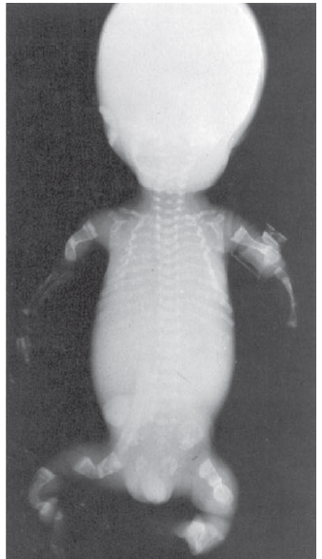
Figure 13-18 Radiograph of a premature (26 weeks’ gestation) infant with the perinatal lethal form (type II) of osteogenesis imperfecta. The skull is relatively large and unmineralized and was soft to palpation. The thoracic cavity is small, the long bones of the arms and legs are short and deformed, and the vertebral bodies are flattened. All the bones are undermineralized.

Slide 44
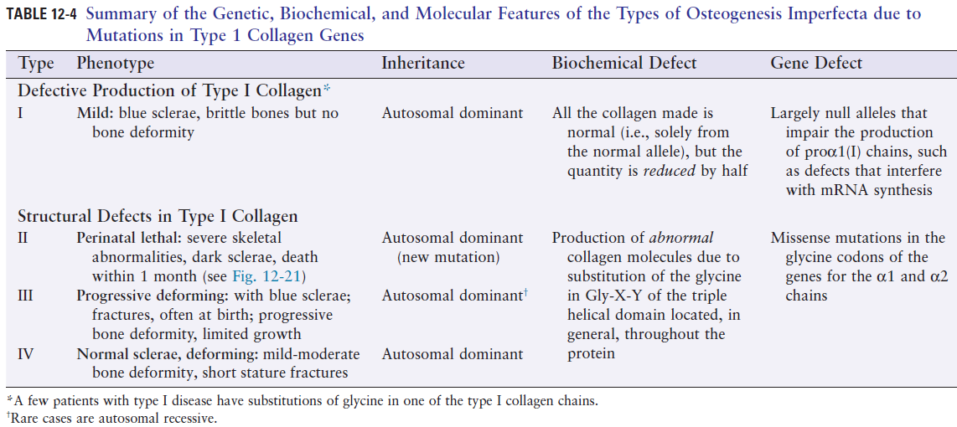

Slide 45
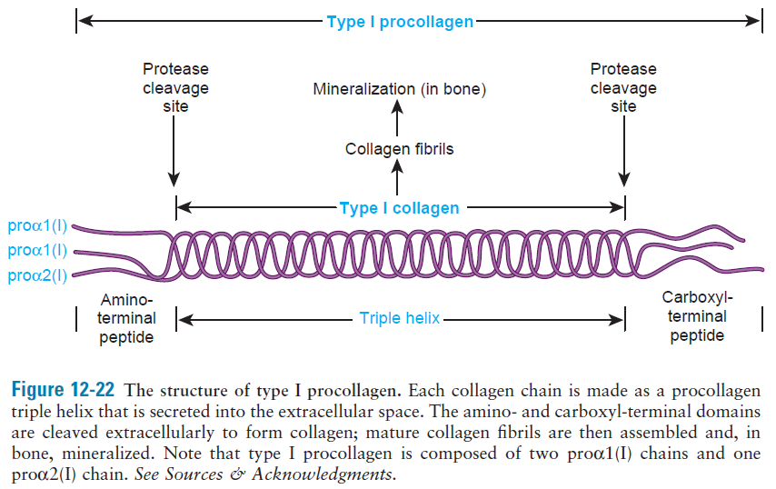
Figure 13-19

Slide 46
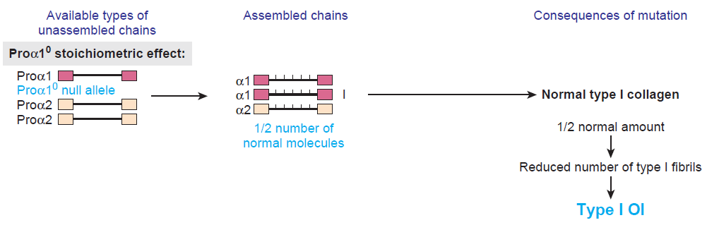
Diminished collagen production
Figure 13-20 The pathogenesis of the major classes of type I procollagen mutants

Slide 47
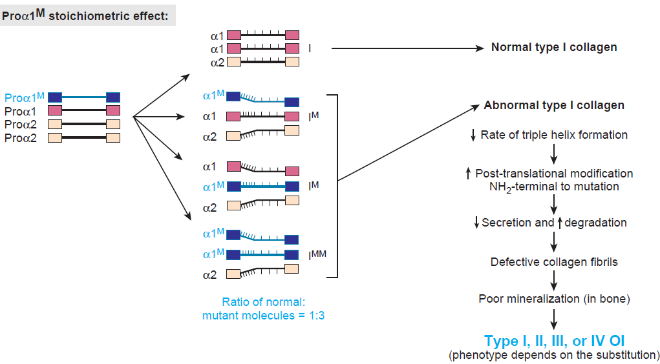
Structurally defective collagens
Dominant negative alleles

Slide 48
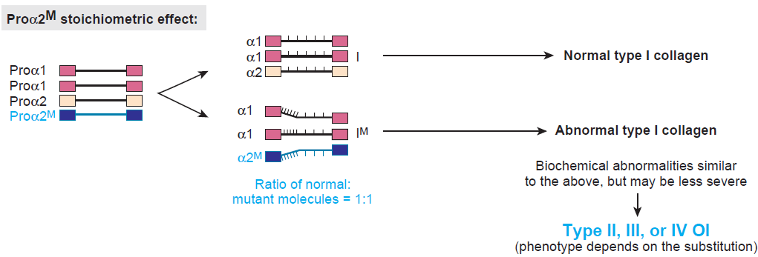
Structurally defective collagens
Dominant negative alleles
In dominantly inherited diseases such as OI, it is actually better to have a mutation that generates no gene product than one that produces an abnormal gene product

Slide 49
The effect of gene duplication and retained function on phenotype
Spinal muscular atrophy (SMA)
Autosomal recessive disease
The most frequent genetic cause of infant mortality
Affecting 1 in 10,000 live births and a carrier rate of 1 in 50
Progressive loss of motor neurons of the spinal cord and motor nuclei of the lower brainstem
Hypotonia, muscle weakness, and atrophy of variable severity

Slide 50
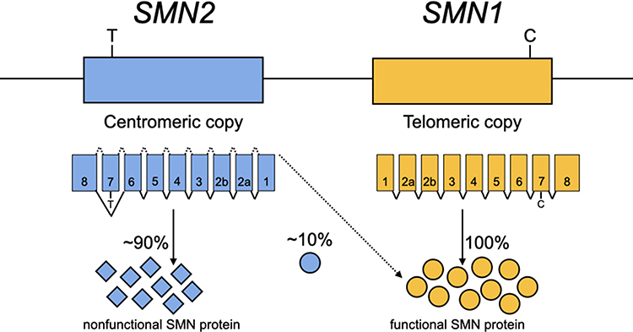
Two genes are responsible for producing the survival motor neuron (SMN) protein, SMN1 and SMN2. SMN1 provides humans with the proper quantity of SMN protein necessary for a normal phenotype. SMN2 is an inverted duplicate of SMN1 lying closer to the centromere. A C>T transition in exon 7 of SMN2 causes the SMN2 gene to produce mostly (~90%) nonfunctional protein and a small amount (~10%) of the functional SMN protein.

Slide 51
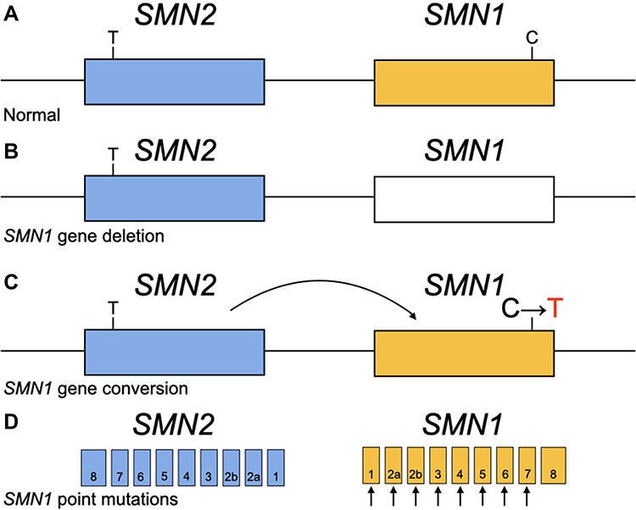
(A) A chromosome carrying a normal copy of SMN1 and SMN2.
(B) The blank box indicates a deleted gene. A deletion can remove part or all of the SMN1 gene.
(C) The curved arrow represents a conversion. With the C>T transition in SMN1, the SMN1 copy now closely resembles SMN2 and is considered SMN2-like.
(D) Point mutations occurring in any of the SMN1 exons prior to the last exon can affect the SMN protein.

Slide 52
Neurodegenerative disorders
Alzheimer disease
Disorders of mitochondrial DNA
Disorders due to expansion of unstable repeat sequences

Slide 53
Alzheimer disease (AD)
Progressive deterioration of memory and higher cognitive functions, such as reasoning, in addition to behavioral changes
Abnormalities reflect degeneration of neurons
Lifetime risk for AD is 12% in men and 20% in women by age 85
AD is mutlifactorial, but ~10% of patients have autosomal dominant monogenic form of AD, caused by mutations in genes encoding:
β-amyloid precursor protein (βAPP)
presenilin 1
presenilin 2
APOE encoding apolipoprotein E is associated with disease through its ε4 allele which increases susceptibility to AD

Slide 54
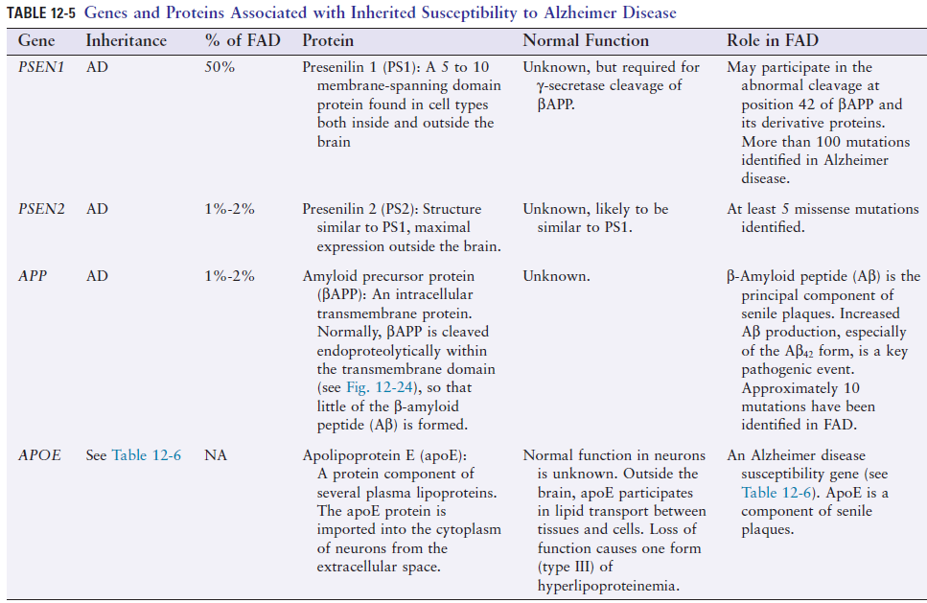

Slide 55
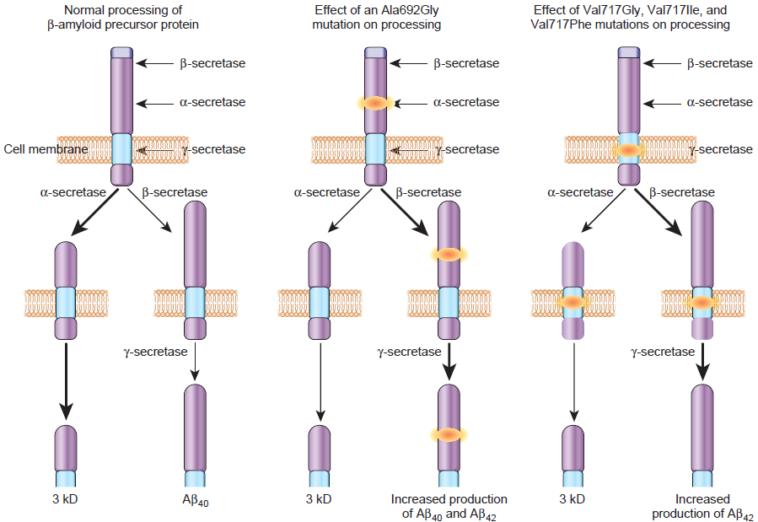
Figure 13-22 The normal processing of β-amyloid precursor protein (βAPP) and the effect on processing of missense mutations in the βAPP gene associated with familial Alzheimer disease.

Slide 56
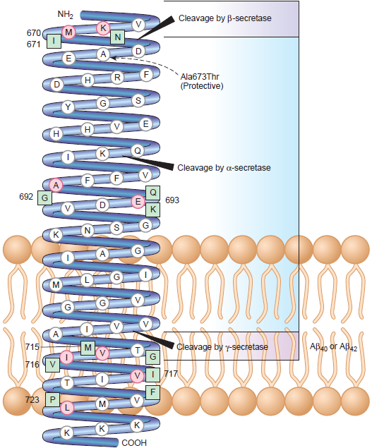
Figure 13-23 The topology of the amyloid precursor protein (βAPP), its nonamyloidogenic cleavage by α-secretase, and its alternative cleavage by putative β-secretase and γ-secretase to generate the amyloidogenic β amyloid peptide (Aβ).
The central role of the Aβ42 peptide in AD is highlighted by the discovery of a coding mutation (Ala673Thr) in the APP gene that protects against both AD and cognitive decline in older adults. The protective effect is likely due to reduced formation of the Aβ42 peptide, reflecting the proximity of Thr673 to the β-secretase cleavage site

Slide 57
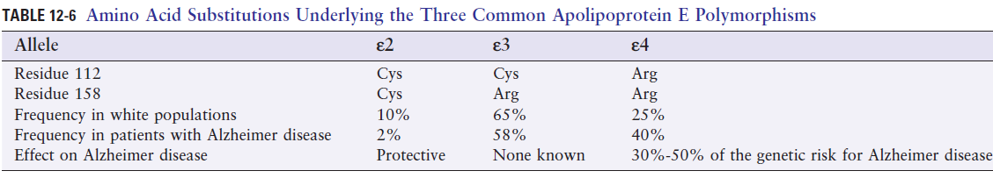
The APOE Gene is an Alzheimer Disease Susceptibility Locus
ε4 allele is significantly overrepresented in patients with AD (~40% vs ~15% in the general population)
ε4 is associated with an early onset of AD (ε4/ε4 homozygotes have 10-15 years earlier age of onset)
Relationship between ε4 and AD is dose-dependent

Slide 58
Diseases of mitochondrial DNA (mtDNA)
Features of mitochondrial chromosomes:
Maternal inheritance
Homoplasmy and heteroplasmy
Replicative segregation
Mitochondrial diseases are characterized by:
Reduced penetrance
Variable expression
Pleiotropy
mtDNA mutates at a rate approximately tenfold greater than does nuclear DNA

Slide 59
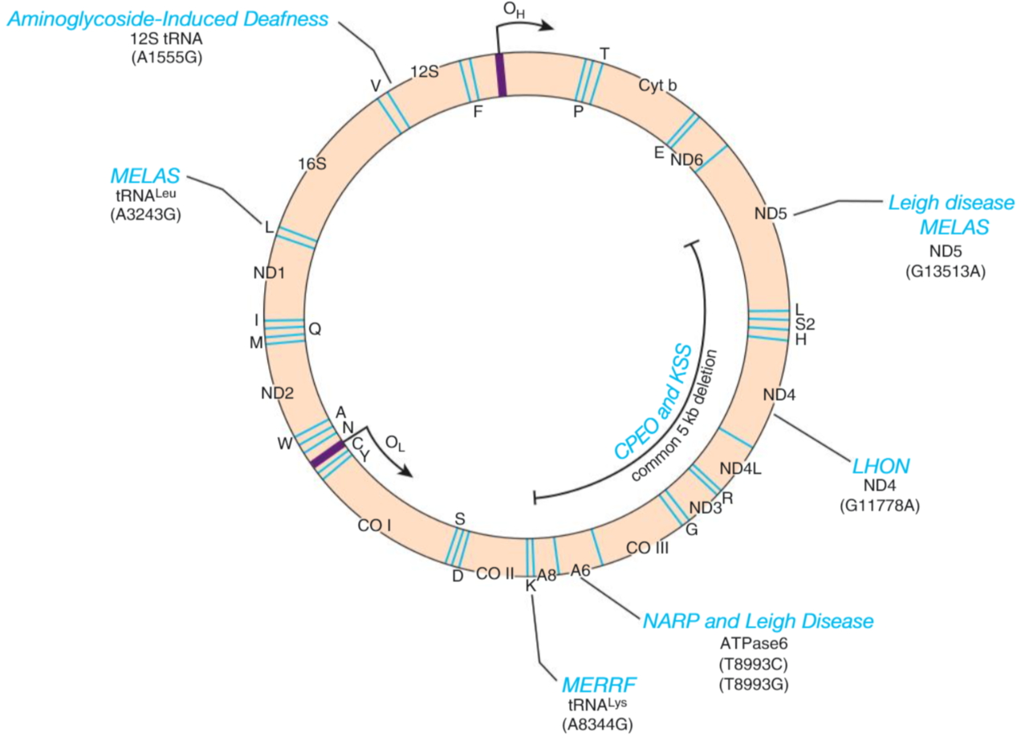
Figure 13-24 Representative disease-causing variants and deletions in mtDNA, 22 tRNAs, 2 rRNAs, and 13 proteins of the oxidative phosphorylation complex.

Slide 60
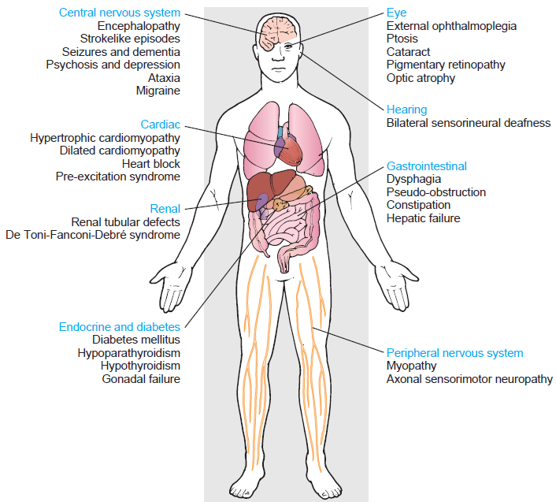
Range of clinical disease is diverse, although neuromuscular disease predominates
Figure 13-25 The range of affected tissues and clinical phenotypes associated with mutations in mtDNA

Slide 61
Three types of mutations have been identified in mtDNA:
Rearrangements that generate deletions or duplications of the mtDNA molecule
Point variants in tRNA or rRNA genes that impair mitochondrial translation
Missense variants in the coding regions of genes that alter the activity of an oxidative phosphorylation protein

Slide 62
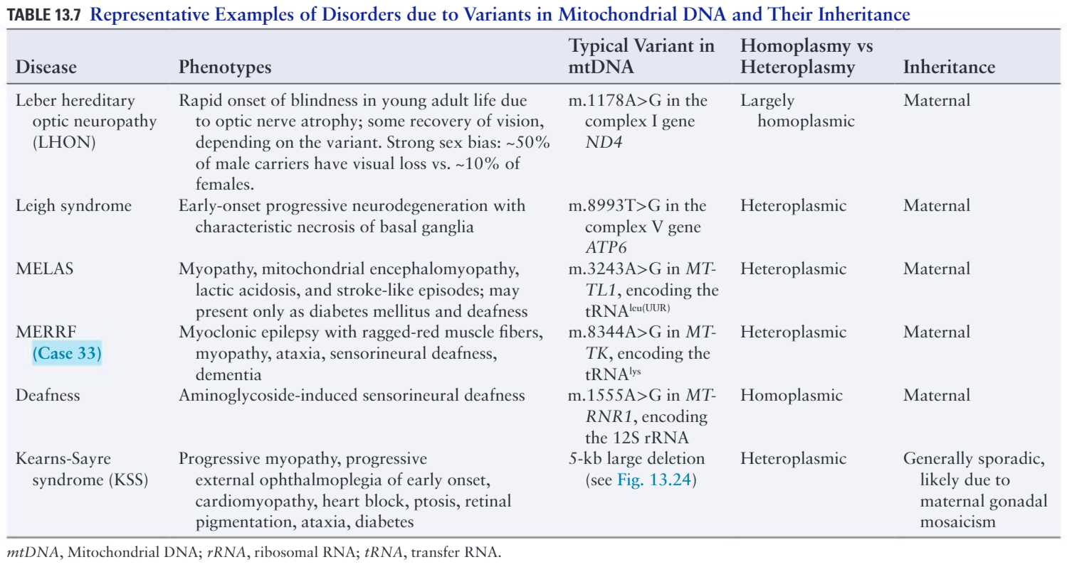

Slide 63
Diseases due to the Expansion of Unstable Repeat Sequences
Diseases due to expansion of unstable repeats are primarily neurological
Diseases of unstable repeat expansion can be divided into three classes:
Class 1: expansion of noncoding repeats that cause a loss of protein expression, e.g. fragile X
Class 2: expansions of noncoding repeats that confer novel properties on RNA, e.g. myotonic dystrophy
Class 3: repeat expansion of a codon such as CAG (for glutamine) that confers novel properties on affected protein, e.g. Huntington

Slide 64
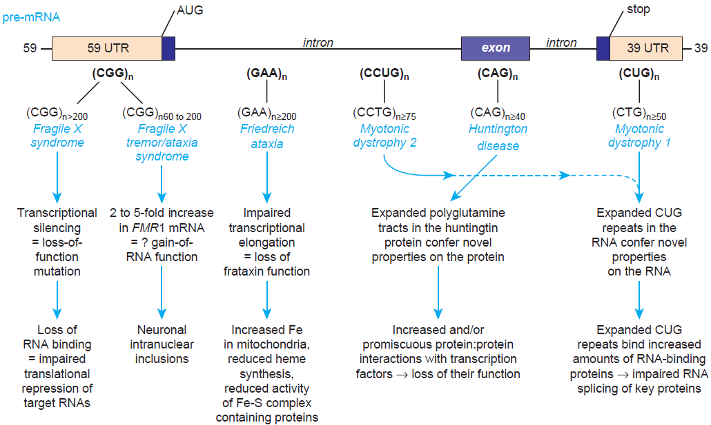
Locations of trinucleotide repeat expansions

Slide 65
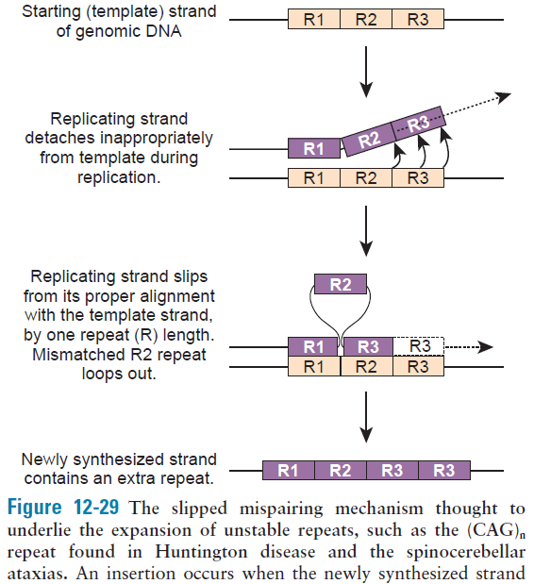
Figure 13-27

Slide 66
Fragile X
Expansion of CGG repeat in the 5’UTR of FMR1 gene leads to excessive methylation of cytosines in the promoter, silencing transcription of the gene
The loss of fragile X mental retardation protein (FMRP) is the cause of the clinical features of the disease
FMRP is an RNA-binding protein that associates with polyribosomes to suppress the translation of proteins

Slide 67
Fragile X tremor/ataxia syndrome (FXTAS)
Repeats 60-200
Entirely different from fragile X
Males with full mutation (fragile X) never develop FXTAS
FXTAS results from twofold to fivefold increased levels of FMR1 mRNA representing gain-of-function mutation
Pathogenic RNA leads to formation of intranuclear neuronal inclusions

Slide 68
Myotonic dystrophy
The most pleiotropic phenotype of all the unstable repeat expansion disorders
DM1 results from a CTG expansion in the 3’UTR of the DMPK gene encoding a protein kinase
DM2 results from a CCTG expansion in the first intron of the gene encoding zinc finger protein 9
Pathogenesis results from the binding of the CUG repeats to RNA-binding proteins. Pleiotropy reflect the broad array of RNA-binding proteins to which the CUG repeats bind
Many of the RNA-binding proteins sequestered by the excessive number of CUG repeats are regulators of splicing. Myotonic dystrophies are referred to as spliceopathies

Slide 69
Huntington disease
Expansion of more than 40 CAG codon repeats in the HTT gene resulting in long polyglutamine tracts in the mutant protein huntingtin
Mutant proteins are novel property mutants, the expanded tract conferring novel features on the protein that damage specific populations of neurons and produce neurodegeneration by unique toxic mechanisms

